Slide 1
Entrepreneurship
Leadership &
Data-Driven
Decision Making
Bruce Bennett, CEO SRM IdeaLab
Laura Kelly, Founding CEO Handwork Studio
Manny Trujillo, CEO Swain Techs
Winfred Sanders, Founding CEO Neta Scientific
Mark Mitchell, Safeguard Scientifics, Discussant
Leslie Mitts, Wharton SBDC, Moderator

Slide 2
Entrepreneurship
Data-Driven Decision Making
Leadership
The ability to look around the corner, galvanize others, and take action.
The ability to use existing data in a new way or obtain new data to make decisions with confidence that creates meaningful change
Notes:
Discuss what these terms leadership and science mean. How are they applicable in the business world? Building a team, deciding on projects and deals versus financial models, valuation methods

Slide 3
Entrepreneurship
Data-Driven Decision Making
Leadership
Sensing opportunities
Working with others
Negotiating
Managing employees
Defining key metrics
Gathering information
Goal setting
Measuring success
Notes:
Discuss what these terms leadership and science mean. How are they applicable in the business world? Building a team, deciding on projects and deals versus financial models, valuation methods

Slide 4
Entrepreneurship
What do great leaders have in common?
Notes:
Leadership is very broad, looks different to everyone. But across the board can make a big impact on the success of a company. Job’s decision to fund Pixar, a perceived poor investment but now very successful.

Slide 5
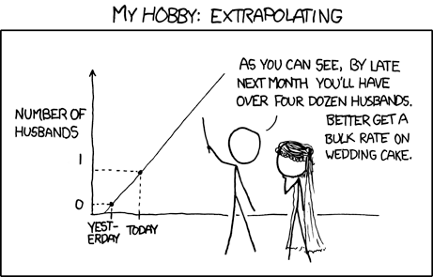
Entrepreneurship
Does data solve all the questions?
Notes:
Too much data and analysis can be a bad thing, not always work. Google flu.

Slide 6
Entrepreneurship
In growing your company,
How have you adapted your leadership and your use of data to create change?
Notes:
Discuss the relevance of the question – personal example? Data changes over time, both in metric and quantity. Leadership develops and changes with needs of the business. How do the 2 work together?

Slide 7
Entrepreneurship
Very Different Businesses… Each has Survived and Thrived for More than 10 Years
Notes:
Leadership is very broad, looks different to everyone. But across the board can make a big impact on the success of a company. Job’s decision to fund Pixar, a perceived poor investment but now very successful.

Slide 8
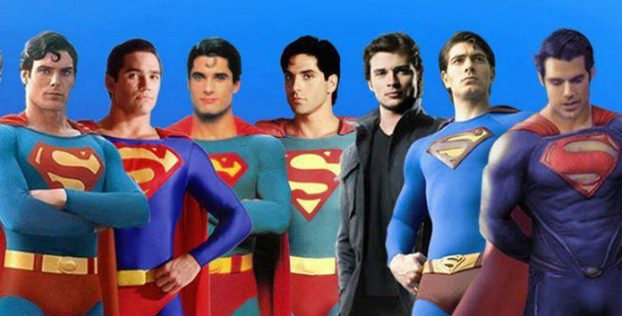
Entrepreneurship
Notes:
How do you know which way to follow in a decision? Is there a way to reconcile the two options? What factors have led to successful decision? Poor decision? Cue panel.

Slide 9
Entrepreneurship
Data/Reports I Used Today
Data/Reports I Used to Use
Time
Leadership Skills I Used to Rely On
Leadership Skill I Rely On Now
Notes:
Leadership is very broad, looks different to everyone. But across the board can make a big impact on the success of a company. Job’s decision to fund Pixar, a perceived poor investment but now very successful.

Slide 10
Entrepreneurship
Mark Mitchell, Safeguard Scientifics, Discussant
Leslie Mitts, Wharton SBDC, Moderator
How would you define your leadership and use of data?
How have they changed?
What was the impact on your business?
Q & A
Bruce Bennett, CEO SRM IdeaLab
Laura Kelly, Founding CEO Handwork Studio
Winfred Sanders, Founding CEO Neta Scientific
Manny Trujillo, CEO Swain Techs
Notes:
Leadership is very broad, looks different to everyone. But across the board can make a big impact on the success of a company. Job’s decision to fund Pixar, a perceived poor investment but now very successful.

